Slide 1

AERO Flight Delays and cancellations
Name: Jessica Williams
Focus: Customer Retention and Operational Disruption
Date: 24AUG2022

Slide 2
What are contributing factors for current low-performing customer retention and high operational disruptions?
Cancellation Code ‘A’ – Airline Causation
Examples: Staffing, Check-ins/Lanes, Maintenance
Cancellation Code ‘B’ – Weather
Examples: Snow, Thunderstorm, Tornado
Cancellation Code ‘C’ – National Aviation System
Examples:non-extreme weather conditions, airport operations, heavy traffic volume, air traffic control,

Slide 3
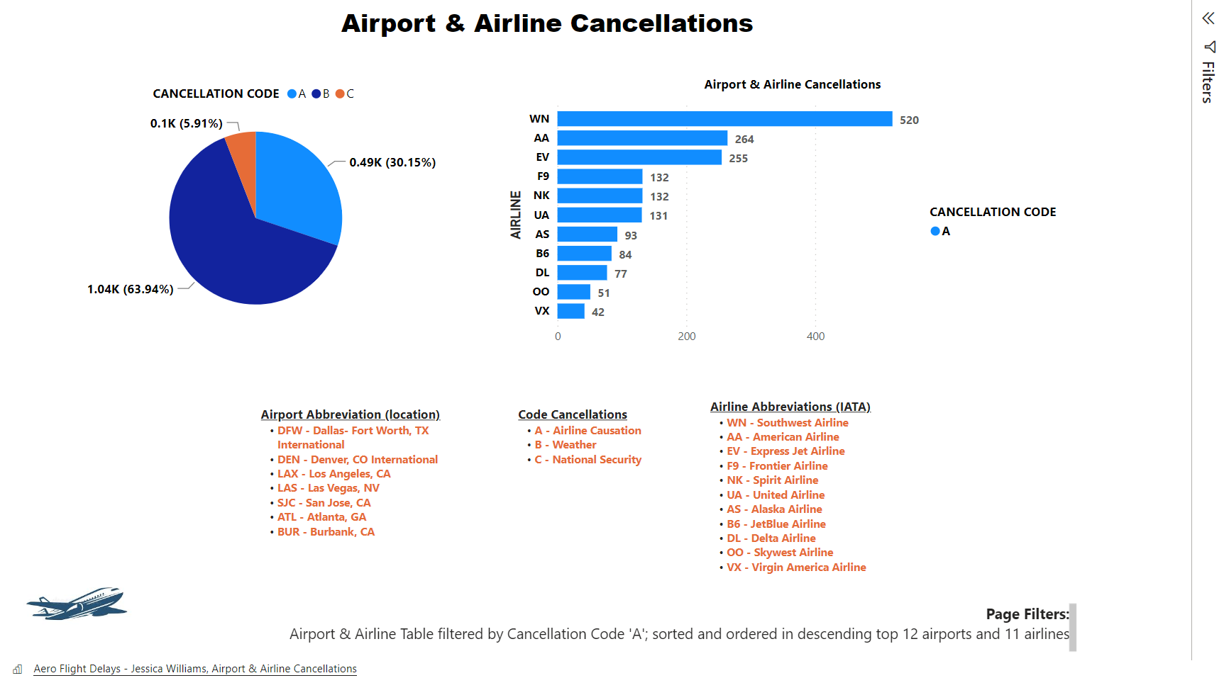

Slide 4
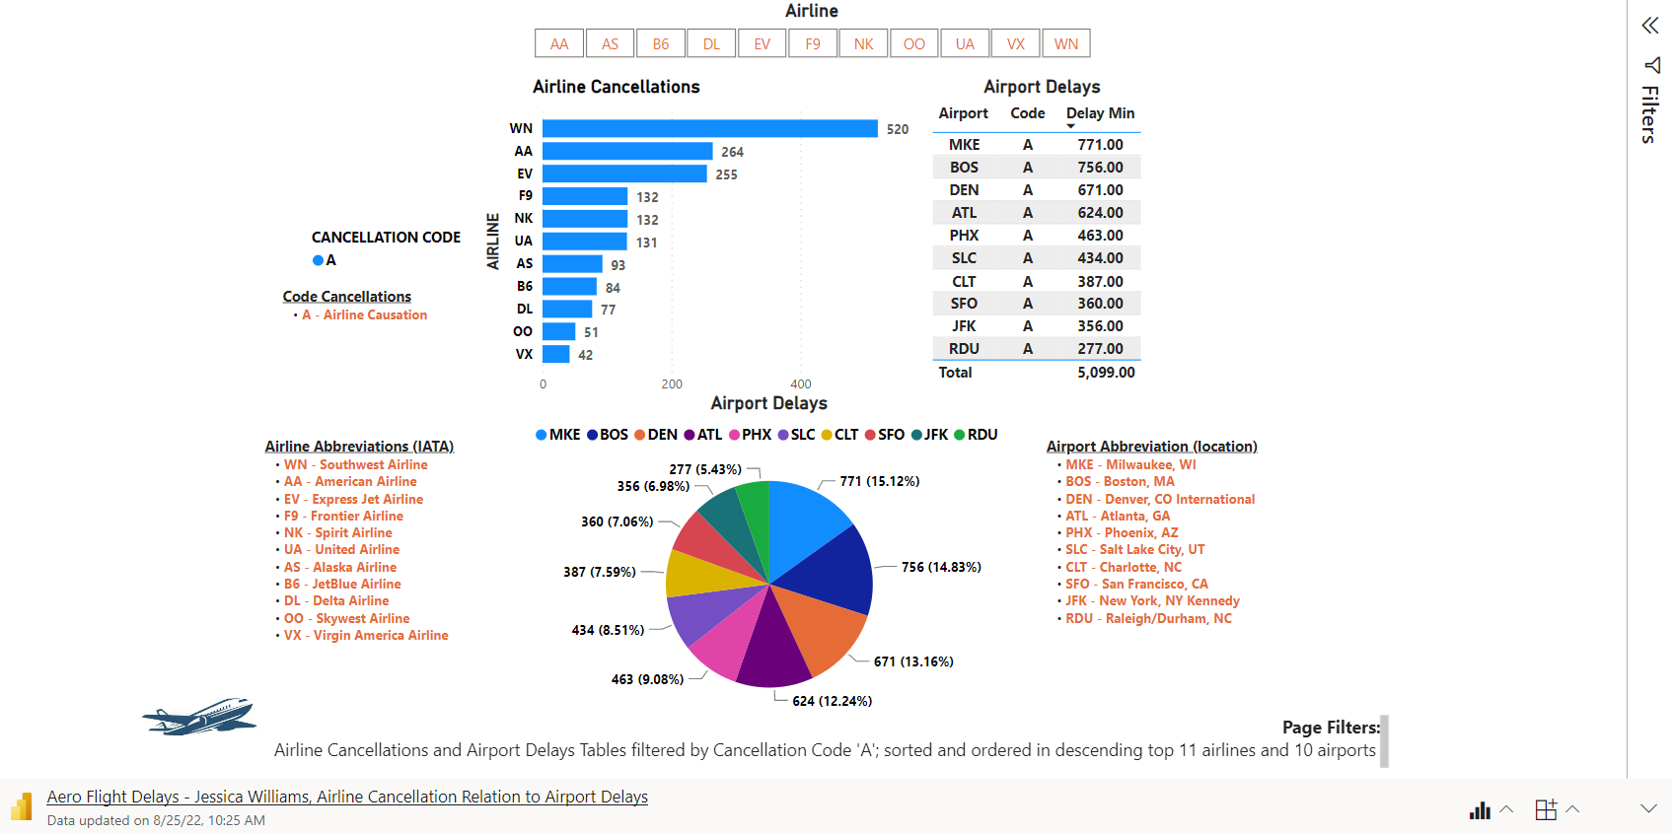
Are there any relations between cancelations and delays?

Slide 5
What are contributing factors for current low-performing customer retention and high operational disruptions?
Staffing, Check-ins/Lanes, Maintenance
Examples: Staffing, Check-ins/Lanes, Maintenance
Cancellation Code ‘B’ – Weather
Examples: Snow, Thunderstorm, Tornado
Cancellation Code ‘C’ – National Security
Examples: Bomb Threat, Hijacking, Prisoner Transport

